Slide 1
Image Suite V4 MR10 Overview

Slide 2
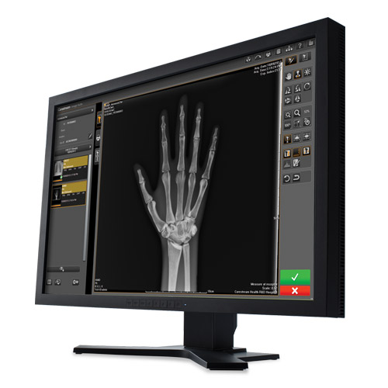
Agenda
Image Suite
V4 MR10
What’s New
Classic CR Mammography Enhancements
DR LLI Auto-Stitching
Focus HD Support
DR TQT
Other Changes
Resolved Issues
Compatibility
Timeline
Resources
Notes:
Considered a maintenance
Many numerous changes including many enhancement requests and resolutions form previous versions
Overview of key changes

Slide 3
Classic CR Mammography Enhancements
Notes:
Only CR Classic

Slide 4
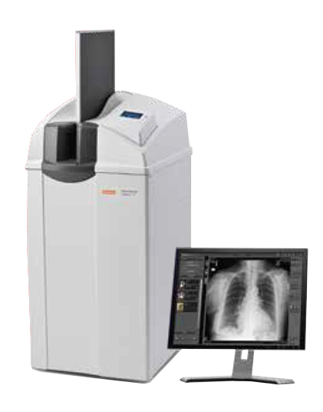
Classic CR Mammography Enhancements
Image Suite
V4 MR10
Closing the Gap to DirectView
The MR10 update features significant mammography enhancements, squarely addressing customer concerns, elevating image quality, streamlining workflow processes, and effectively narrowing the gap with other software versions.
Advanced Image Quality
Enable Eclipse to look type selection and the default setting
Extended slide range for image tuning
Enable skin line and width tuning
Enhanced implant image algorithms
Multiple Format Print Settings
Remove the laterality (left/right) from the view name
Auto-orientation of Mammography image (left views)
Pre-set default Mammography Procedures
Notes:
Changes for CR mammo is the big part of this release, and it closes the gap between previous IS and DirectView to address customer complaints
Here is a quick snapshot of what we will cover in the next few slides

Slide 5
Classic CR Mammography Enhancements
Enabled Eclipse Look Selection
Image Suite now supports 9 premium processing looks.
Same as DirectView
Mammography views only
LookName | EclipseLookName | DisplayName
PremNoise | CR_PremNoise | Premium Image Processing 1
PremFixed1 | CRPrem-Fixed1 | Fixed Image Processing
Prem-US-Alt-A | CRPrem-US-Alt-A | Premium Image Processing 2
Prem-US-Alt-B | CRPrem-US-Alt-B | Premium Image Processing 3
Prem-US-Alt-C | CRPrem-US-Alt-C | Premium Image Processing 4
Prem-US-Alt-D | CRPrem-US-Alt-D | Premium Image Processing 5
BaselineNoise | CR_BaselineNoise | Baseline Image Processing
Prem-US-Alt-E | CRPrem-Alt-E | Premium Image Processing 6
Prem-US-Alt-H | CRPrem-Alt-H | Premium Image Processing 7
MR9
MR9 only supported one look.
Benefit
Sites now have access to a full array of premium processing looks, enabling them to select the one that aligns with their unique preferences.
Notes:
Laid the slides out the same way – Green in new/MR10, blue is old, and Orange benefit
Same as direct View
Images Coming

Slide 6
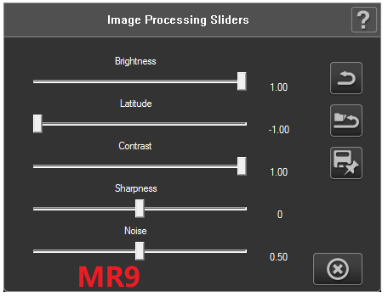
Classic CR Mammography Enhancements
Extended Slider Range
The range of the sliders has been increased to match the capabilities of DirectView.
Brightness: -6.0~6.0 Step: +/- 0.1
Latitude: -7.0~7.0 Step: +/- 0.1
Contrast: -7.5~7.5 Step: +/- 0.1
Sharpness: -3.0~3.0 Step: +/- 0.1
Noise: -3.5~3.5 Step: +/- 0.1
Mammography views only
MR9
MR9 only had a range of -1.0 to 1.0
Benefit
Equips sites with more control and flexibility to fine tune images to meet their preference.
90kVp @ 40 mAs
Notes:
Same as directview

Slide 7
Classic CR Mammography Enhancements
Enabled Skin Line Enlargement
Now supports Skin Line feature and allows the width to be tuned
Default is skin line is enabled with the value set to 1.00
The range is 0 to 3.00 in steps of +/-0.1
Same as DirectView
Mammography views only
MR9
MR9 did not support skin line feature
Benefit
User can utilize Skin Line Enlargement feature to clearly visualize the skin line.
Notes:
Same as directview

Slide 8
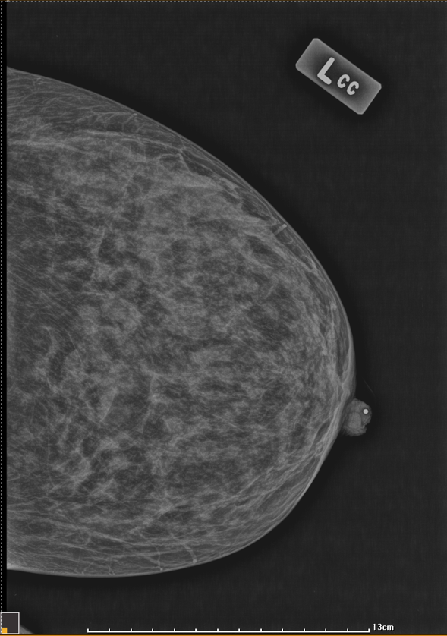
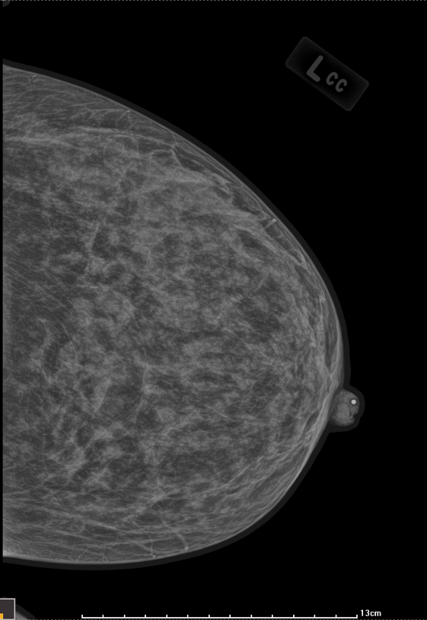
Skin Line Enlargement
Disabled
Enabled

Slide 9
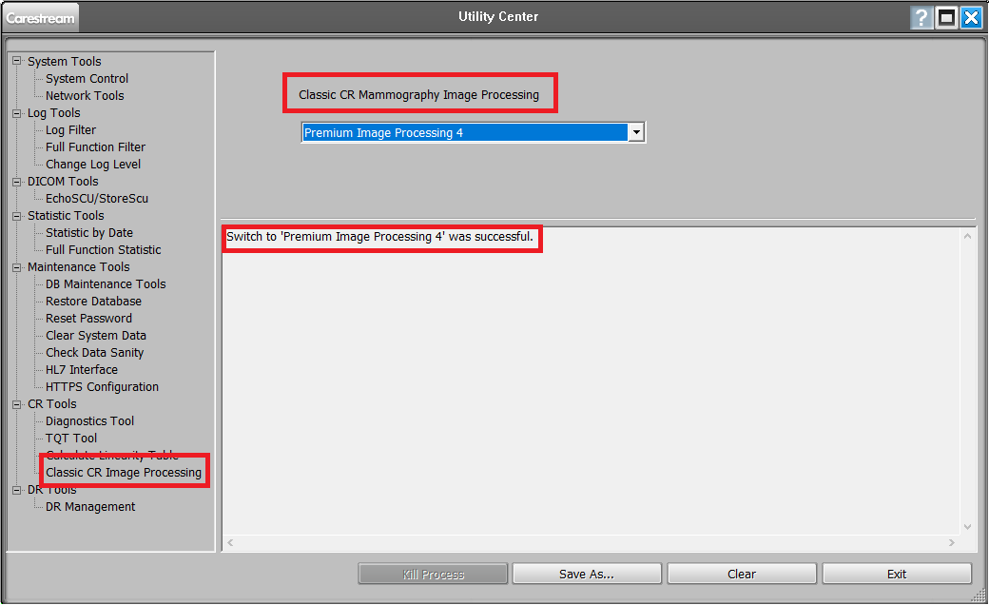
Classic CR Mammography Enhancements
Save Look as Customer Default
The preferred image Look along with Brightness, Latitude, Contrast, Sharpness and Noise slider adjustments can now be save as customers default.
Skin Line does not save as customer default.
Mammography views only
MR9
MR9 did not allow saving looks as default.
Benefit
Saves image slider settings as the default to boost workflow by eliminating the need to adjust each image manually every time and also ensures consistent image quality.

Slide 10
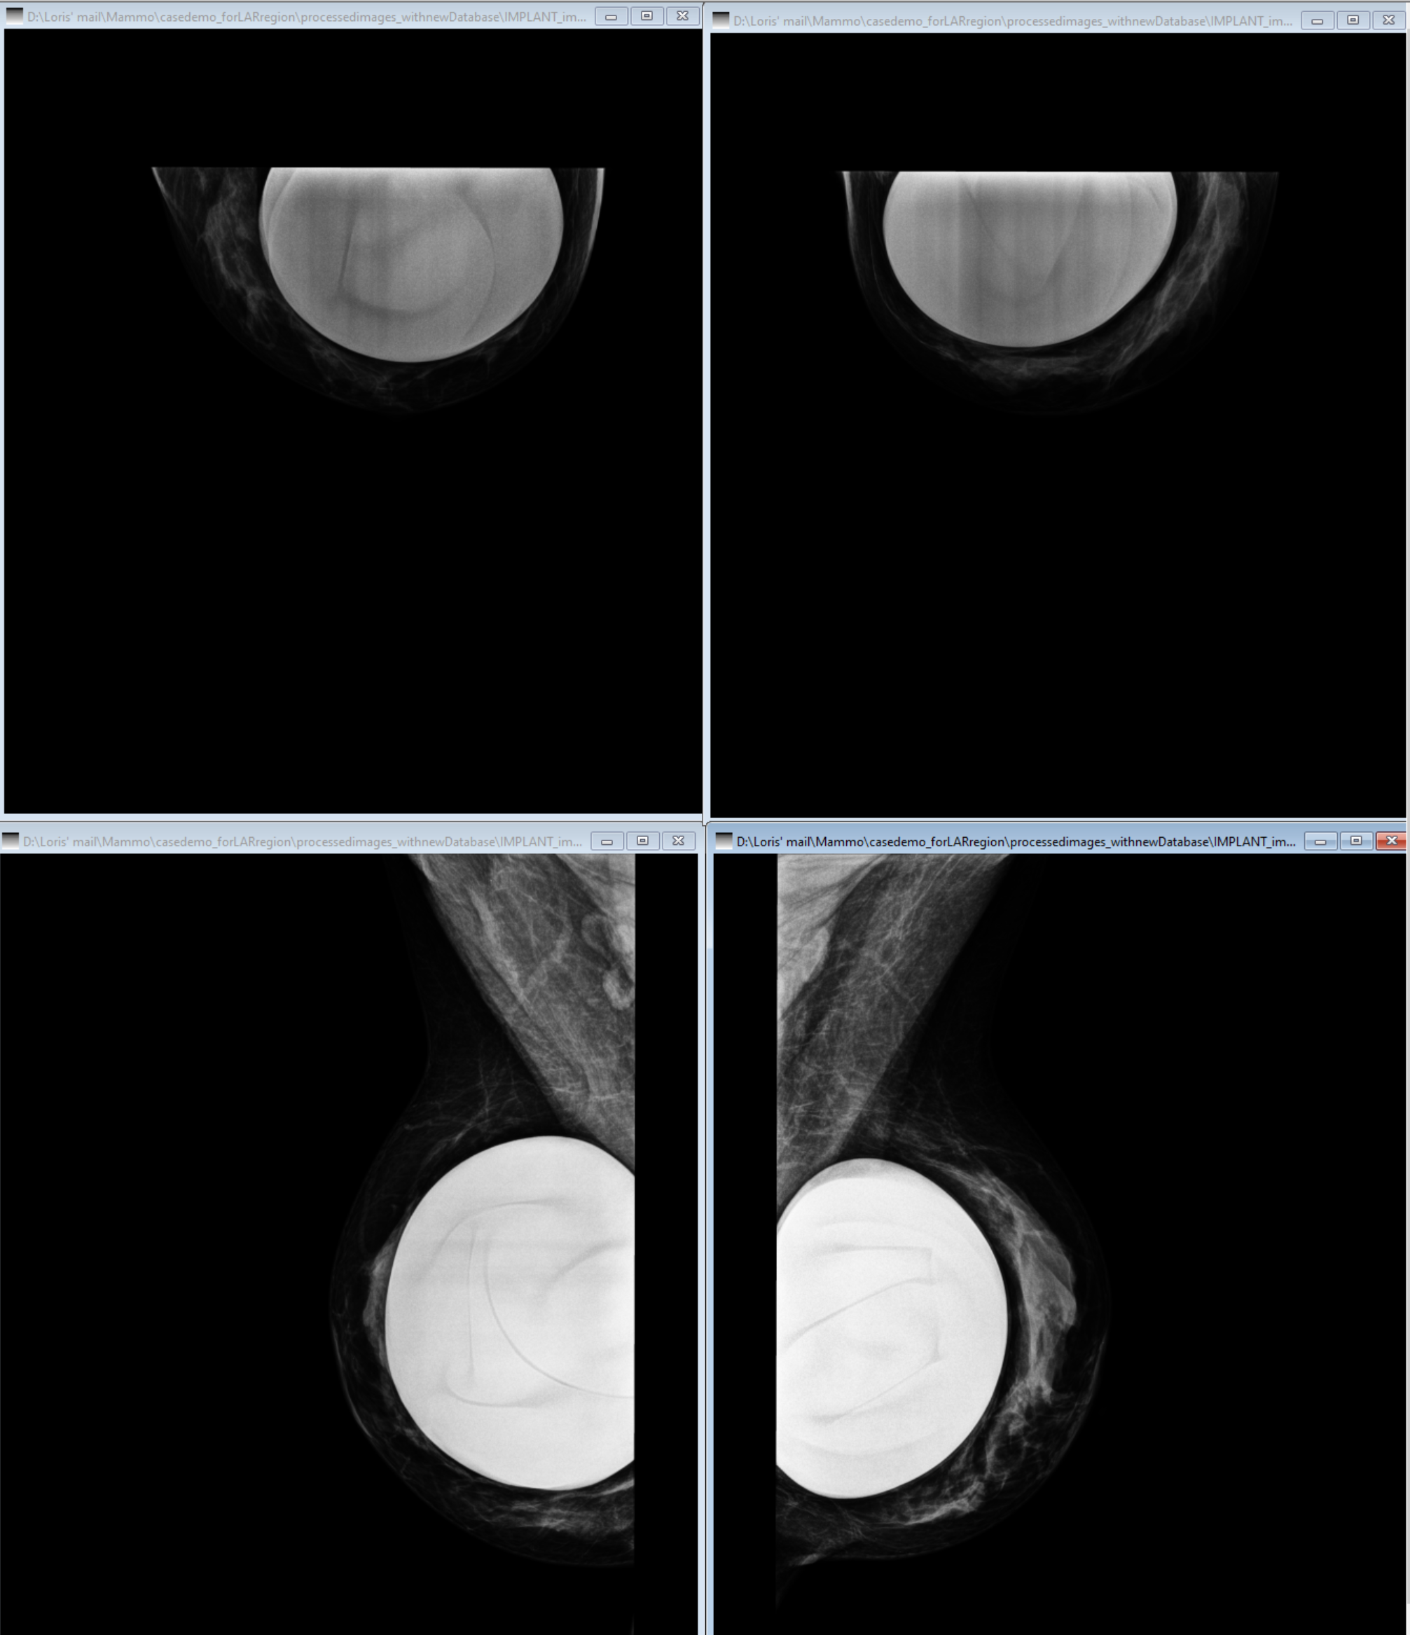
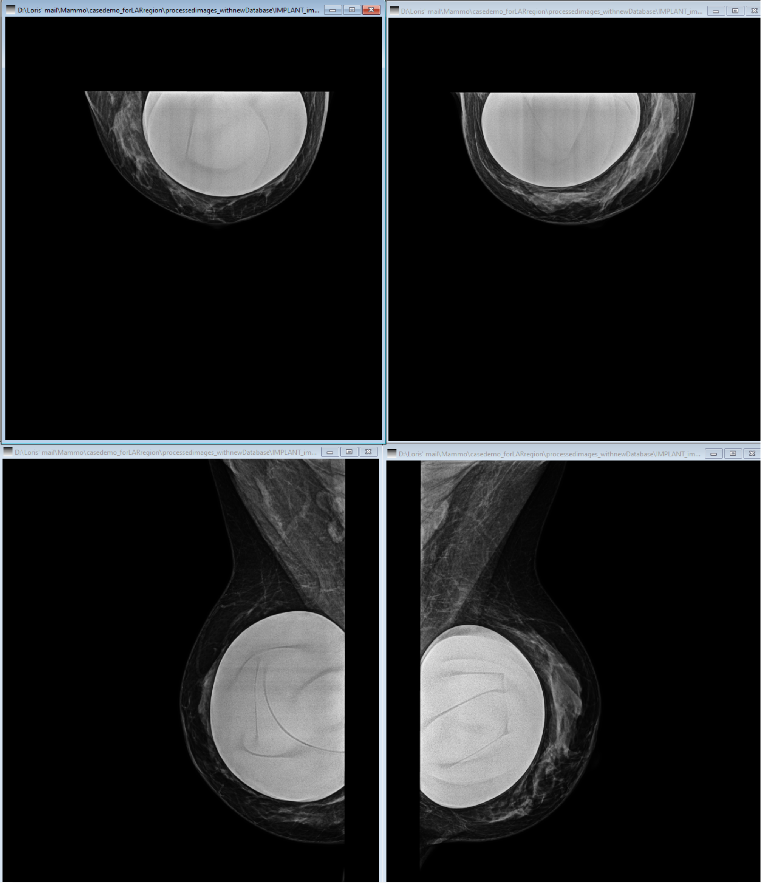
Classic CR Mammography Enhancements
Enhanced Implant Processing Performance
New image processing algorithm has been optimized for breast implant images, enhancing the ability to see skin line.
Results of new processing algorithm deliver better results than previous DirectView images.
Mammography views only
MR9
MR9 did not have implant algorithms.
MR9
MR10
Benefit
Elevated image quality to enhance diagnostic confidence. Increased visibility of skin line, decreased brightness of implant, and better visualization of tissue next to implant.
Notes:
Better than DirectView

Slide 11
Enhance Implant Processing Performance
Increased soft tissue visualization next to implant
(reduced ringing artifact)
MR9
Increased skin line visualization
MR10

Slide 12
Enhance Implant Processing Performance
MR9
MR10
Increased skin line visualization
Decreased implant brightness
Increased soft tissue visualization
next to implant (reduced ringing artifact)

Slide 13
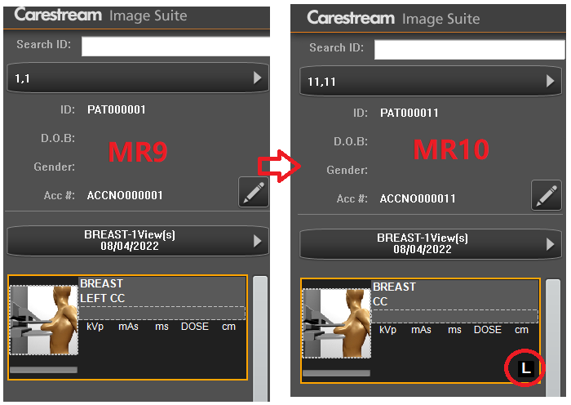
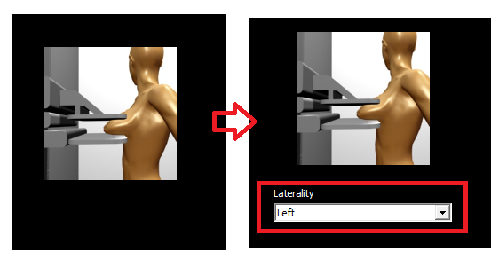
Classic CR Mammography Enhancements
MR9
MR10
Laterality Removed from View Name
Removed the laterality (left/right) from the view name.
Added laterality drop down field in center stage.
User can select from four options:
Unspecified(U), Left(L), Right(R), Both(B)
Default laterality is Unspecified (U)
Laterality icon will be added to the view selection tile
Same As DirectView
Only applies to mammography views
MR9
MR9 assigns laterality in view name, which is not consistent with standard practice and will result in duplicate naming.
Benefit
Address customer complaints and eliminates potential for duplicate naming in PACS.

Slide 14
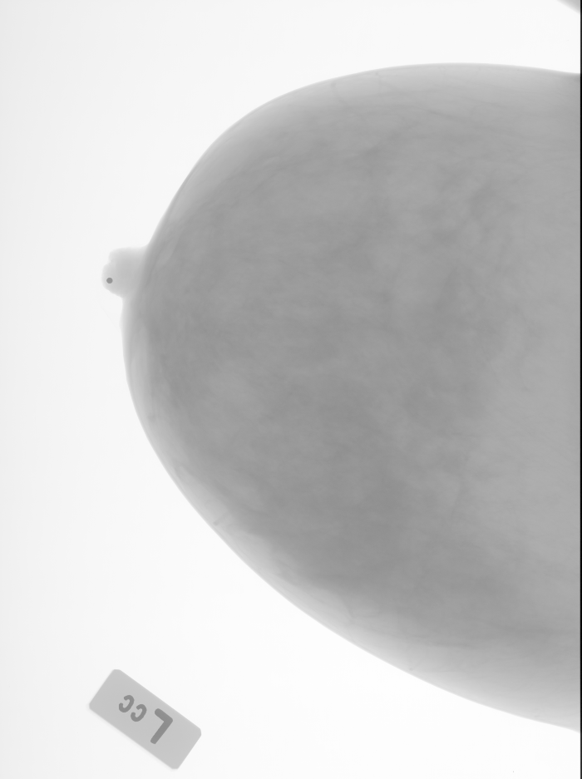
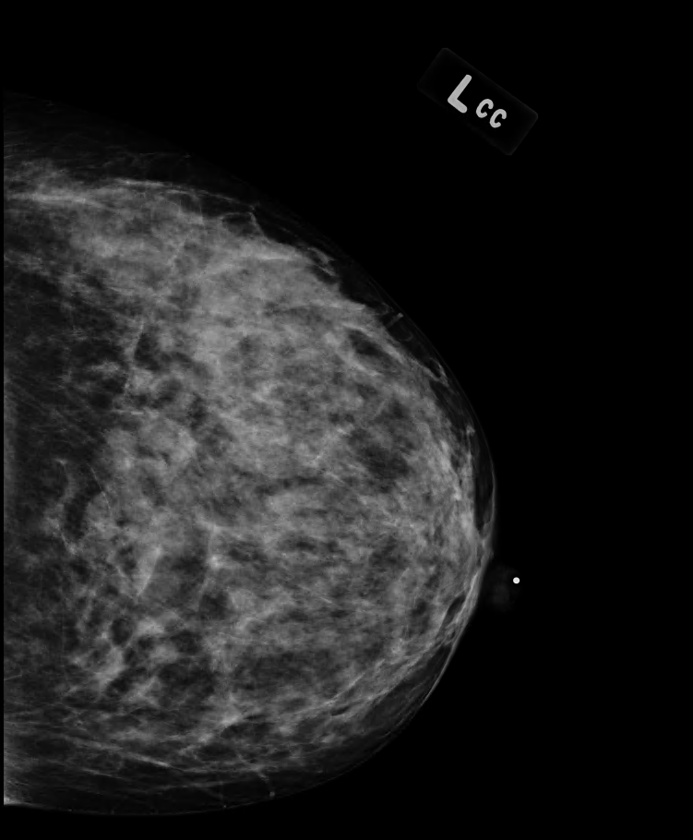
Classic CR Mammography Enhancements
Left Mammo Views Auto-Rotation
Captured Image
Displayed Image
Enable auto-rotation to automatically rotate left mammography views into the correct orientation.
Operates the same as DirectView.
180º
Mammography views only
MR9
MR9 did not automatically rotate the image resulting in left/right image pointing the same direction.
Benefit
The image will automatically rotate to display correctly, eliminating the need to manually rotate the image to increase ease of use for the customer.

Slide 15
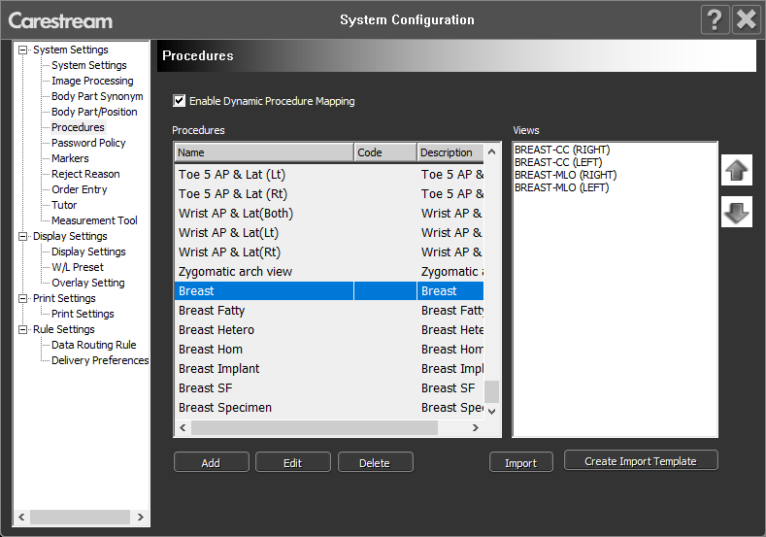
Classic CR Mammography Enhancements
Pre-set Default Mammography Procedures
Introduces a set of pre-defined commonly used mammography procedures and associated views.
Same as DirectView.
MR9
MR9 does not have any pre-set default mammography procedures.
Benefit
Customer no longer has to manually create the procedures themselves, or has a starting point to work from.
Decreases overall setup time.

Slide 16
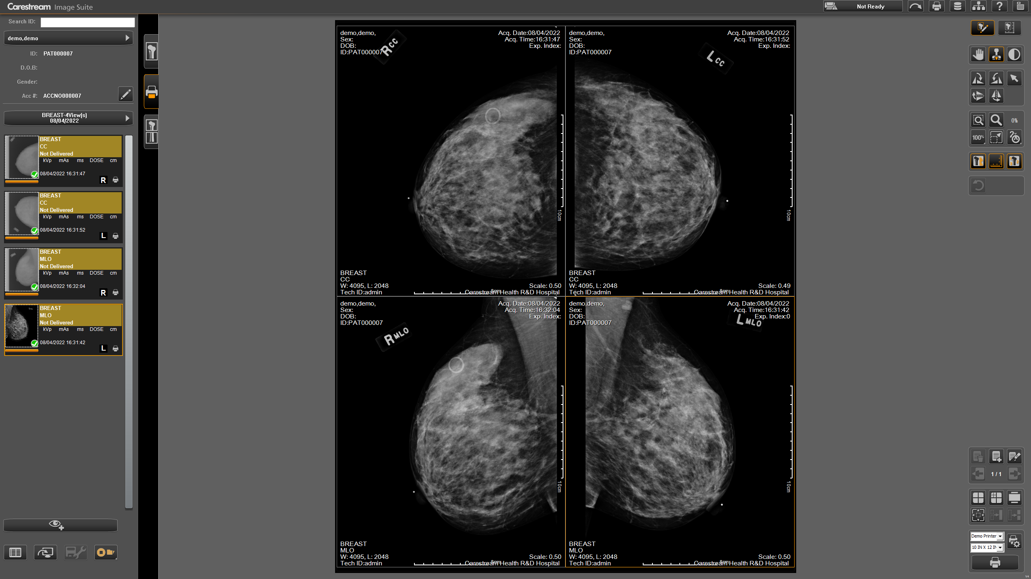
Classic CR Mammography Enhancements
Multiple Format Print Settings
Enables multi-format printing similar to DirectView.
The system will apply a default print setting for the procedure.
User can modify/delete the print setting.
All Views
MR9
MR9 only allows manual printing
Benefit
Customer no longer has to manually arrange the images for each examination prior to printing.

Slide 17
Classic CR Mammography Enhancements
Enhancement | Benefit
Enabled Eclipse Look Selection | Site can choose from nine premium processing looks, enabling them to select the one that aligns with their unique preferences.
Extended Post-Processing Slider Range | Gives user more control and flexibility to fine tune images to meet their preference.
Enabled Skin Line Enlargement | User can utilize Skin Line Enlargement feature to clearly visualize the skin line.
Save Look as Customer Default | Saves image slider settings as the default to boost workflow by eliminating the need to adjust each image manually every time and also ensures consistent image quality.
Enhance Implant Processing Performance | Increases visibility of skin line, decreased brightness of implant, and better visualization of tissue next to implant to elevated image quality and enhance diagnostic confidence.
Laterality Removed from View Name | Eliminates potential for duplicate naming in PACS, improving overall ease of use and user satisfaction.
Auto-Rotation for Left Mammography Views | The image will automatically rotate to display correctly, eliminating the need to manually rotate the image to increase ease of use for the customer.
Pre-set Default Mammography Procedures | Decreases overall setup time as customer no longer has to manually create the procedures themselves from scratch.
Multiple Format Print Settings | Customer no longer has to manually arrange the images for each examination prior to printing boosting their productivity.

Slide 18
Focus HD Support¹
¹ Not available in all regions

Slide 19
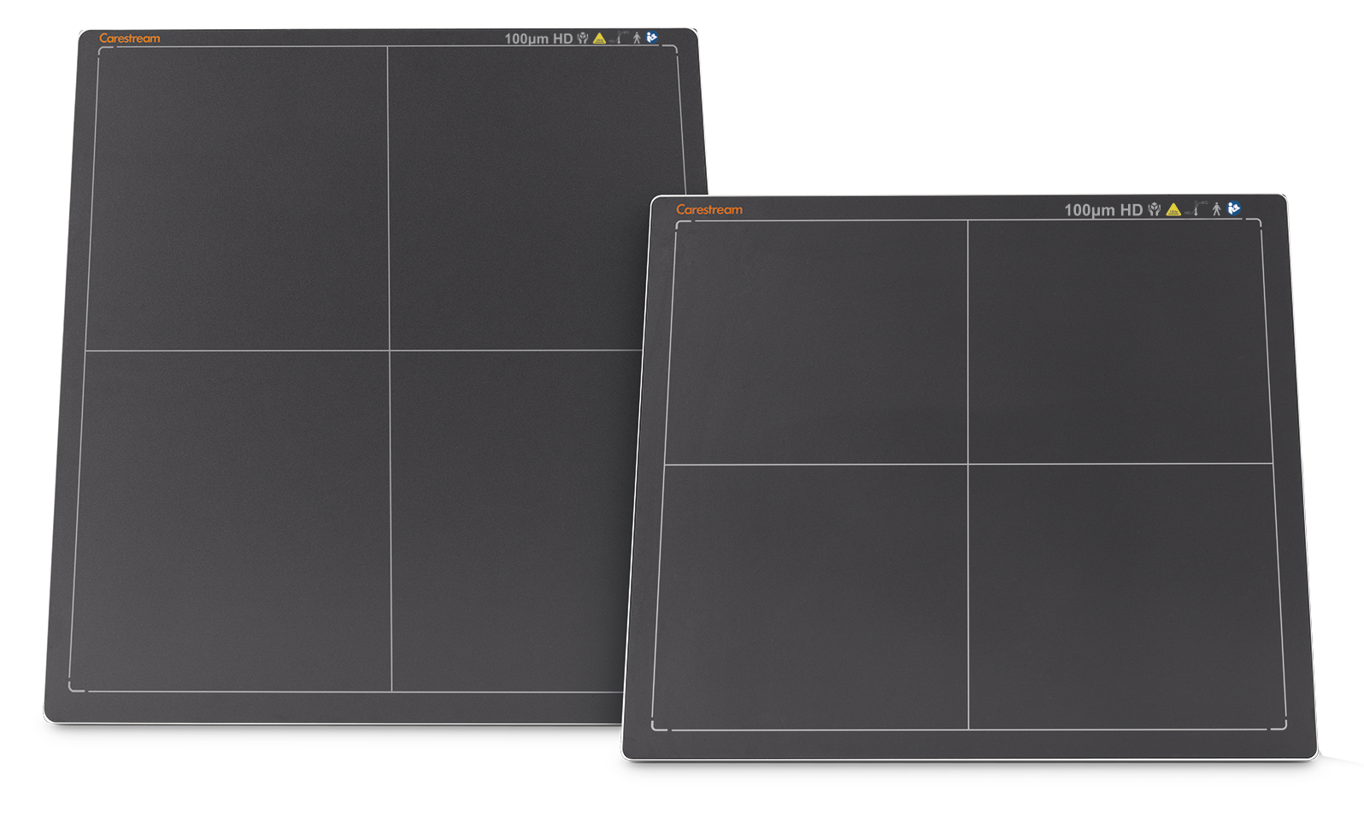
Focus HD Detectors
MR10
Now supports Focus HD 35/43 detectors.
Operates the same as other detectors
Human Medical use only.
MR9
MR9 did not support Focus HD.
Benefit
Customer now has the ability to choose from a wider range of detectors, including a high resolution option.

Slide 20
Automatic DR LLI Stitching²
¹ Not available in all regions

Slide 21
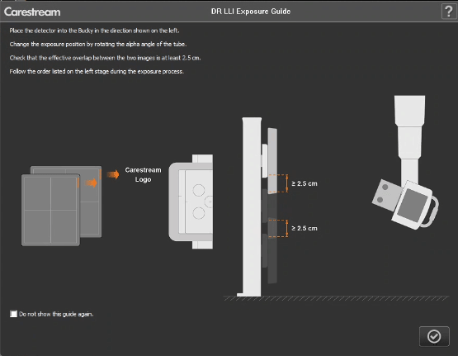
Automatic DR LLI Stitching
MR10
Supports automatic DR LLI image stitching.
Images are captured individually and stitched automatically together by the software.
User still retains the ability to manually stitch or adjust.
User can force stitch if not using all the preset views.
Standard feature
MR9
MR9 only had manually DR stitching.
Benefit
This will significantly enhance workflow efficiency as there is no longer a need for manual stitching DR LLI images together.
Notes:
Will review process

Slide 22
Automatic DR LLI Stitching
Auto Stitch
OVERVIEW

Slide 23
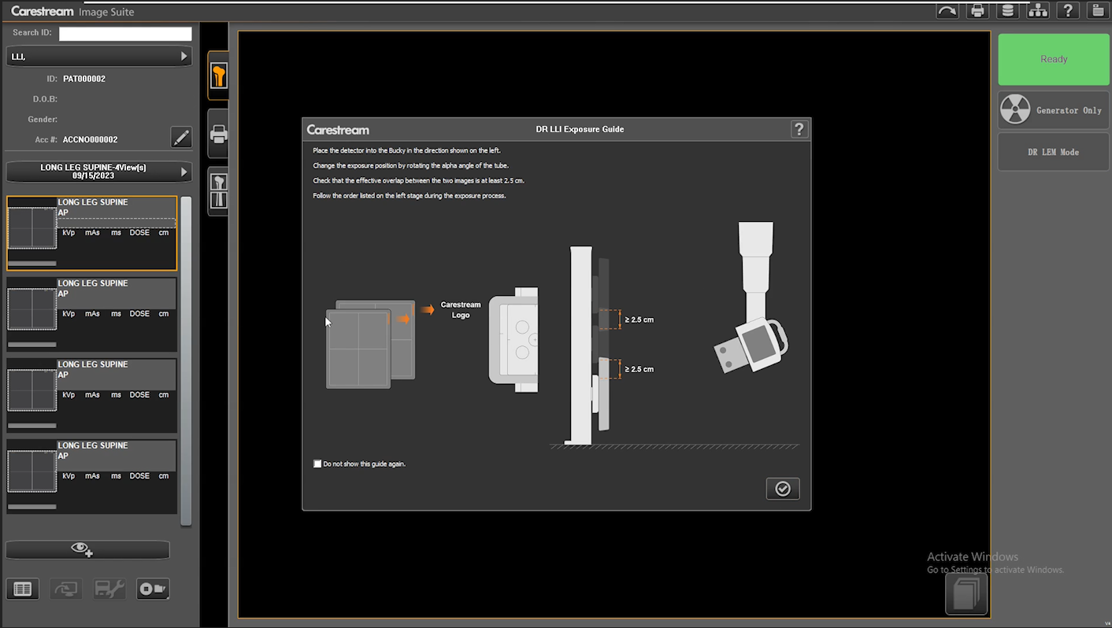
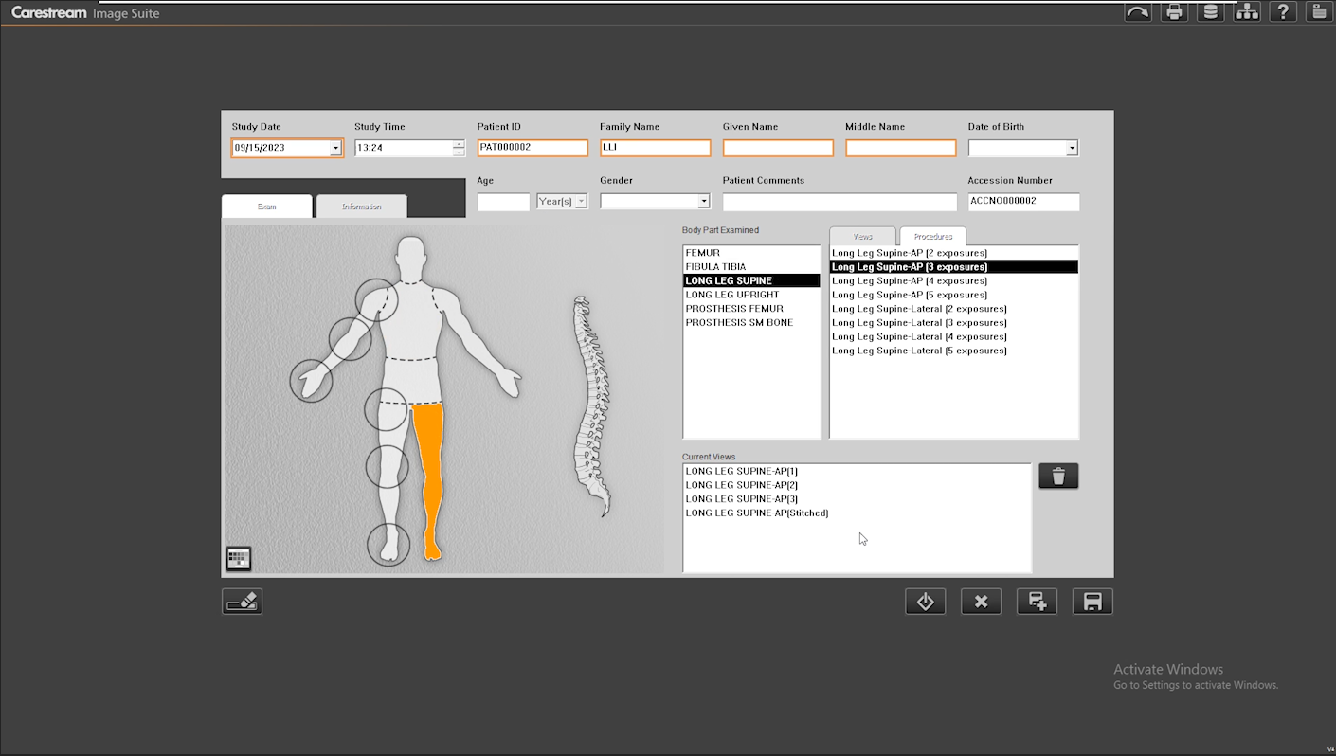
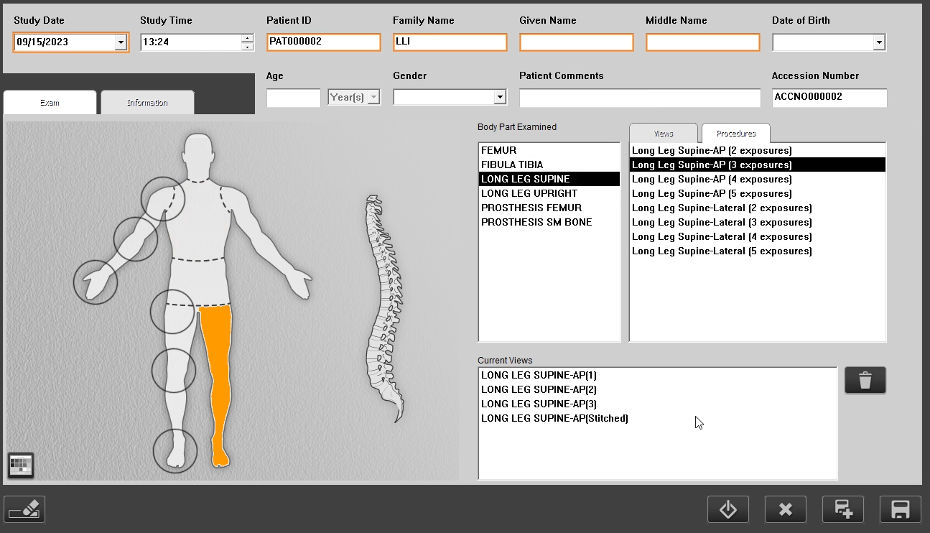
Automatic DR LLI Stitching
Auto Stitch
Select LLI Procedure
Notes:
Anything to add?

Slide 24
Automatic DR LLI Stitching
Auto Stitch
Select LLI Procedure
Review Instructions
Notes:
2.5 cm overlap
Where to position Carestream logo
Can not show if you want

Slide 25
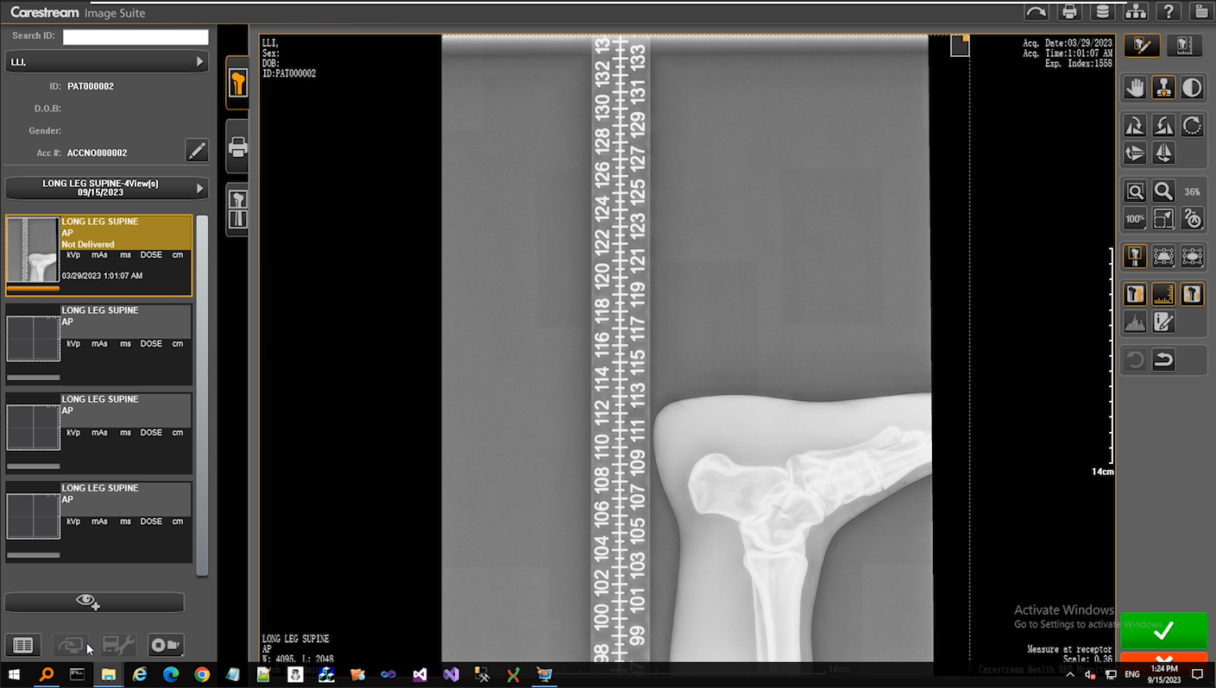
Automatic DR LLI Stitching
Auto Stitch
Select LLI Procedure
Review Instructions
Capture 1st Image
Notes:
Anything to add?

Slide 26
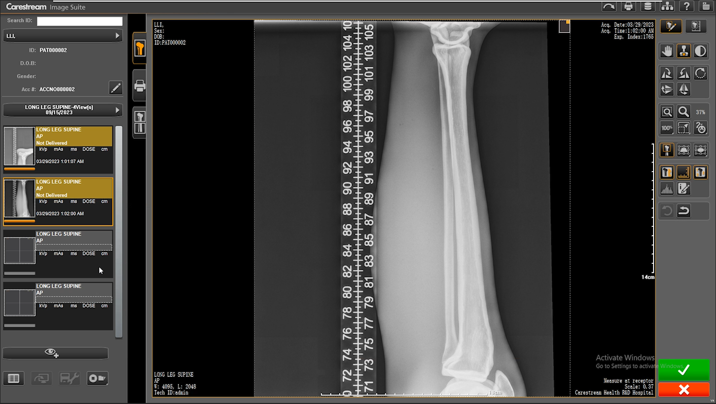
Automatic DR LLI Stitching
Auto Stitch
Select LLI Procedure
Review Instructions
Capture 1st Image
Capture 2nd Image
Notes:
Anything to add?

Slide 27
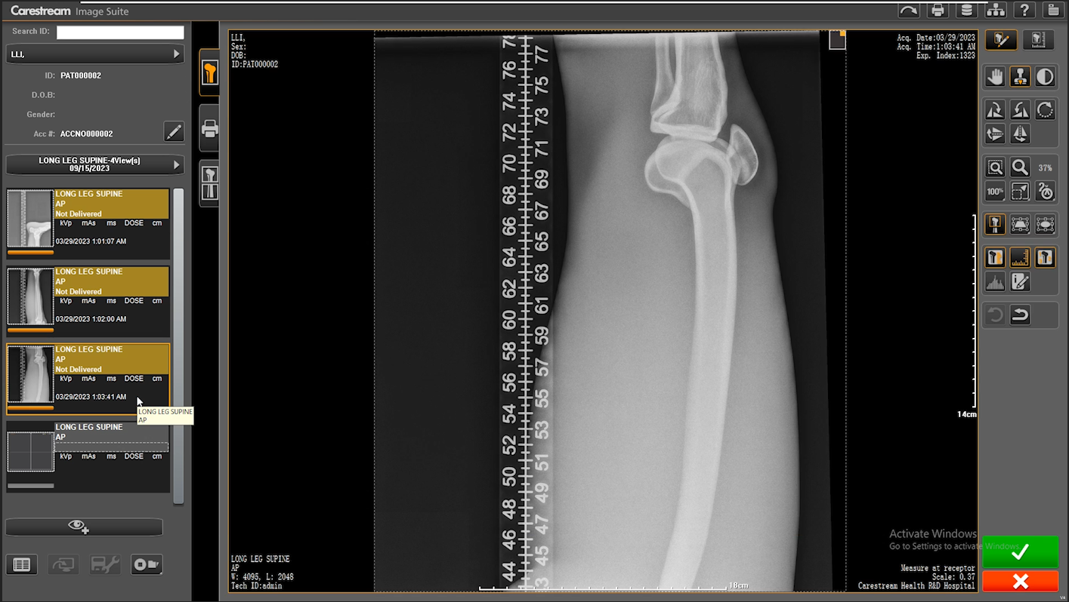
Automatic DR LLI Stitching
Auto Stitch
Select LLI Procedure
Review Instructions
Capture 1st Image
Capture 2nd Image
Capture 3rd Image
Notes:
Anything to add?

Slide 28
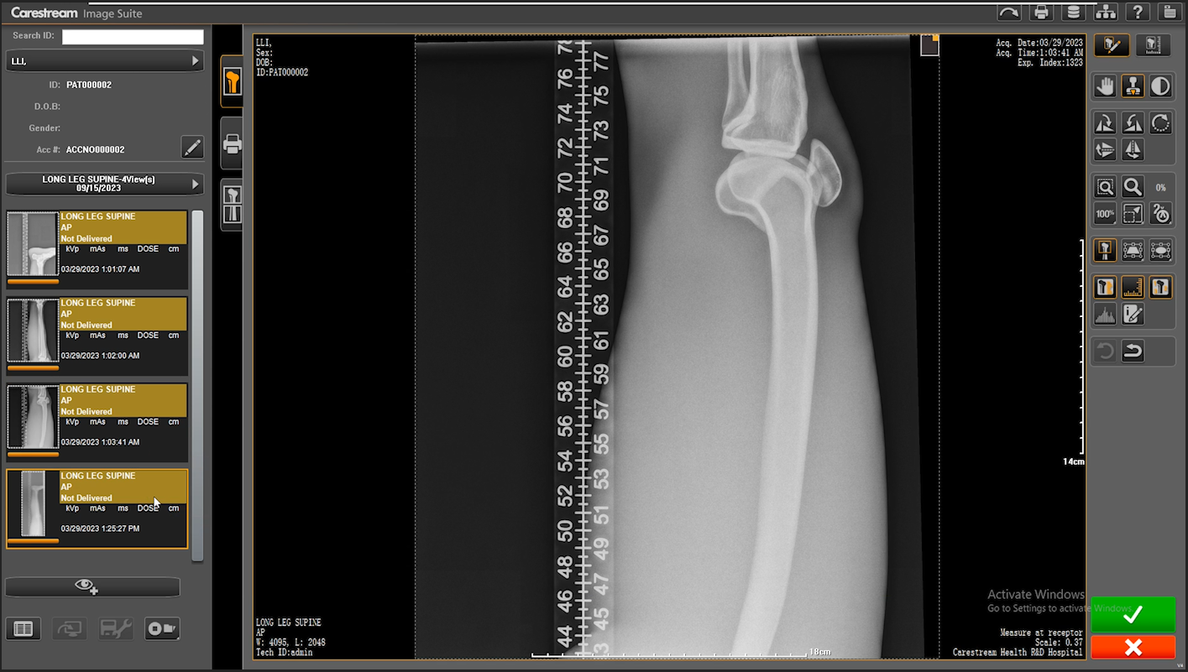
Automatic DR LLI Stitching
Auto Stitch
Select LLI Procedure
Review Instructions
Capture 1st Image
Capture 2nd Image
Capture 3rd Image
System mage will begin stitching images
Notes:
Anything to add?

Slide 29
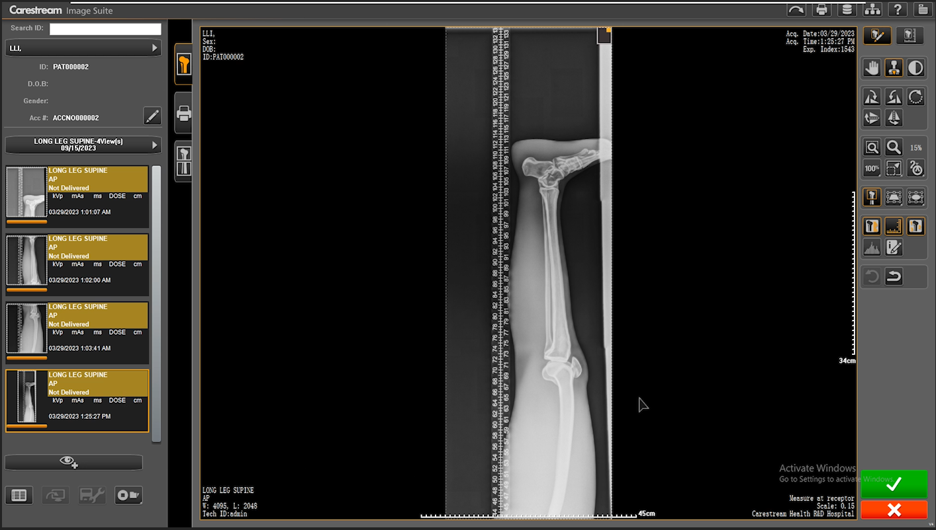
Automatic DR LLI Stitching
Auto Stitch
Select LLI Procedure
Review Instructions
Capture 1st Image
Capture 2nd Image
Capture 3rd Image
System mage will begin stitching images
Composite image will appear after processing complete
Notes:
Anything to add?

Slide 30
Automatic DR LLI Stitching
Force Stitch
If you do not need to use all the image tiles, you can force the image to auto stitch.

Slide 31
Automatic DR LLI Stitching
Force Stitch
If you do not need to use all the image tiles, you can force the image to auto stitch.
Capture required images

Slide 32
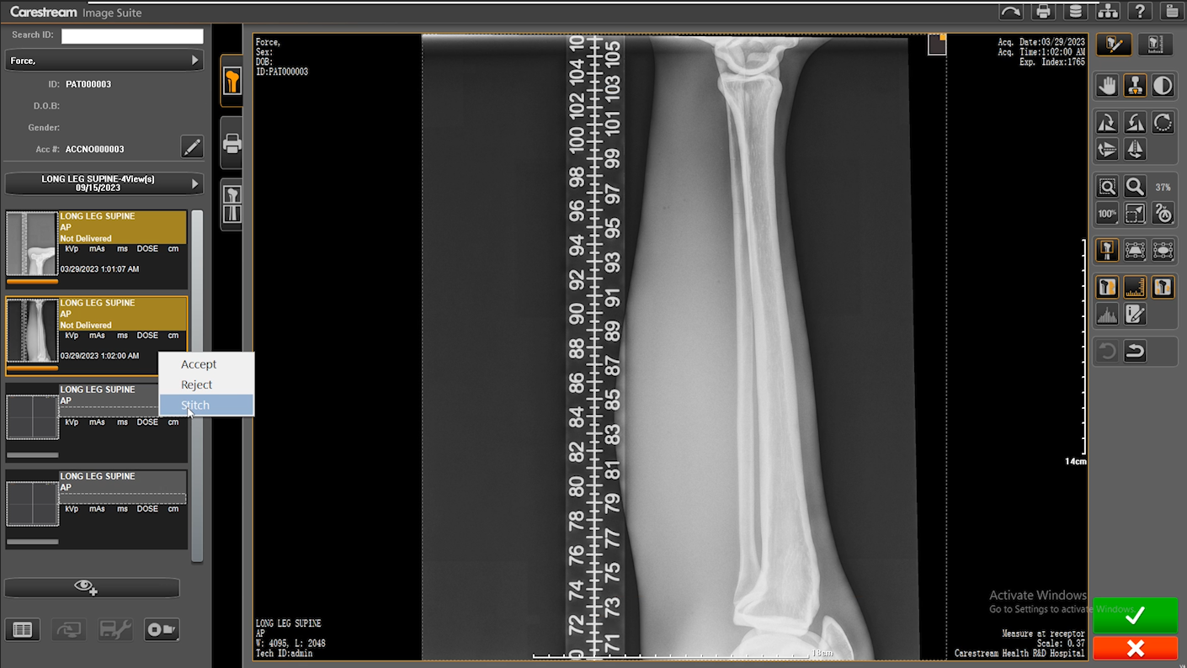
Automatic DR LLI Stitching
Force Stitch
If you do not need to use all the image tiles, you can force the image to auto stitch.
Capture images
Right click and select Stitch

Slide 33
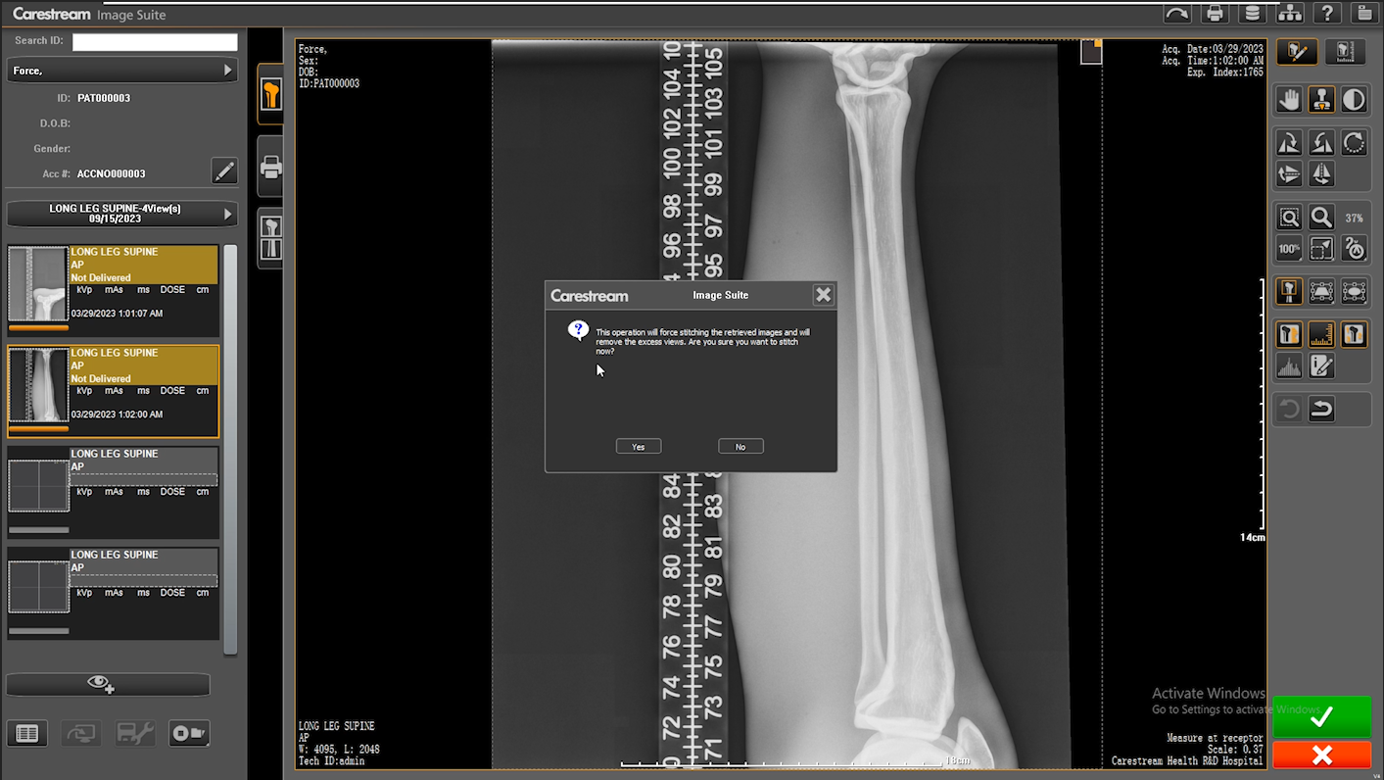
Automatic DR LLI Stitching
Force Stitch
If you do not need to use all the image tiles, you can force the image to auto stitch.
Capture images
Right click and select Stitch
Click Yes

Slide 34
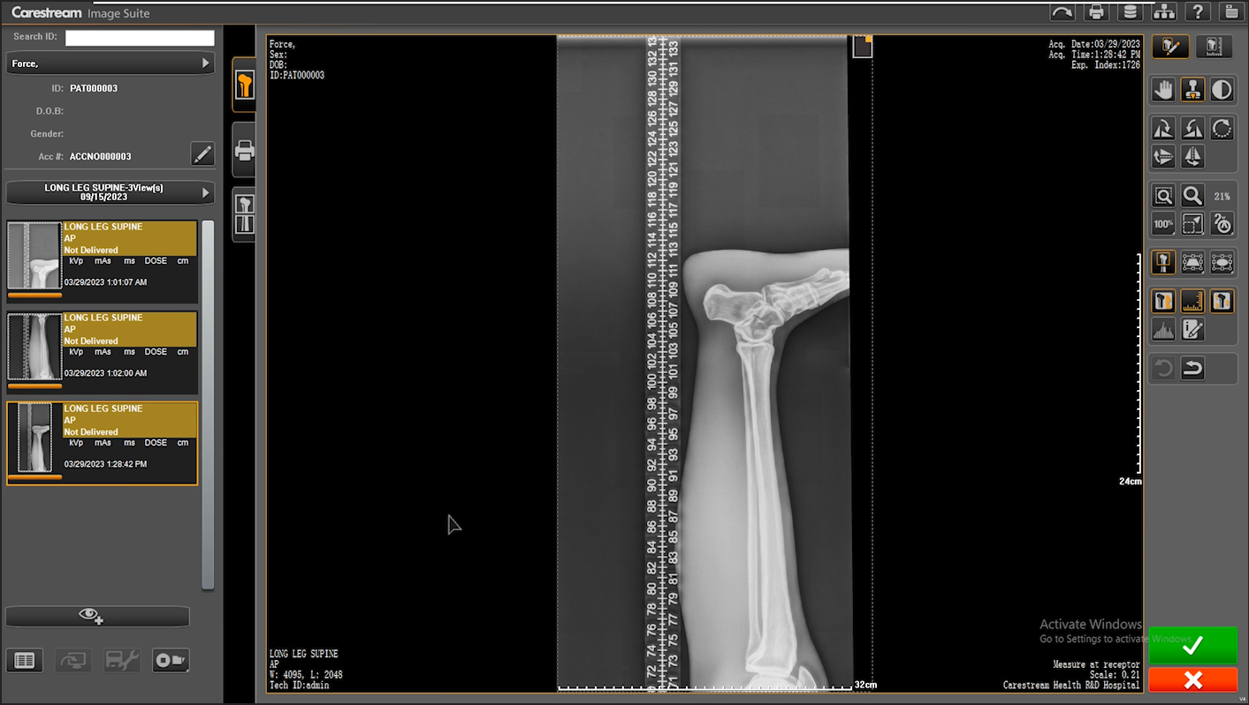
Automatic DR LLI Stitching
Force Stitch
If you do not need to use all the image tiles, you can force the image to auto stitch.
Capture images
Right click and select Stitch
Click Yes
Composite image will appear after processing complete
Notes:
Still retain all the manual stitching options as before

Slide 35
DR TQT SUPPORT

Slide 36
DR TQT Support
MR10
Image Suite now supports DR TQT
Allows DR TQT analysis to pe performed.
This feature is available only if the DR Total Quality Tool option is installed.
This feature is only supported on Focus/TRIMAX/Focus HD detectors.
MR9
MR9 did not support DR TQT.
Benefit
Enables sites to perform a complete set of tests for a truly comprehensive QC management program and verification of the performance of DR Detectors.

Slide 37
Other Updates

Slide 38
Other Changes
Image Suite
V4 MR10
Password Policy Changes
Increase password strength/complexity requirements
Not open to customer, open to service
Security Audit Log Changes
Increase logging level – Logs almost very action user has completed
Previous logging level was very low
SecureLink Permission for non-Carestream Printer
SecureLink permission is required to add/setup a non-Carestream printer
Windows Update Blocking
System will block Windows auto-update feature for Windows 10/11.
Eliminates any potential impact/interference with Image Suite operation
Notes:
Anything to add?

Slide 39
Other Changes
Image Suite
V4 MR10
ARUBA AP Support
Supports the HP ARUBA IAP-505 AP
Allows selection of 36E and 149E
Enables the detector and console communicate with the most advance 802.11ac
Support for XENON XP1950h 1D Barcode Scanner
Supports HONEYWELL XENON XP1950h Healthcare Scanner
Current scanner is end of life.
New Language Support
New language support for:
Serbian
Indonesian
Image Recovery Utility Version 2.8
Updated to support new mammography image field changes
Notes:
Anything to add?

Slide 40
Resolved Issues
Image Suite
V4 MR10
ADO ID | Description
536094 | Comma symbol is displayed after the Patient Name in the Print Panel and Film.
578384 | Image Suite does not block the auto-update OS on MR9 with Win11.
579960 | Preview image displayed in small size; it should be fit to window.
579962 | The black surround mask cannot be applied after cropping the image.
580513 | Two drive icons on desktop need to delete after install completed.
584778 | There will be one error message displayed when upgrade MR8 (applied the Hotfix4022).
585215 | The off-line studies are not accessible.
587443 | If user changes nothing on the patient edit page but click the “Save” button then there is an editing record.
587544 | IS service has to be re-registered manually sometimes after upgrading to V4MR9.
589000 | The tool measure from horizontal which does not change color.
590473 | Image Suite cannot load DICOM image with (0010,2201),(0010,2203) or (0010,2292)
595884 | "Detector Integration Manager" service stops by itself intermittently - Lots of DIP logs.
597688 | [MR9] Unable to open URL Link via Microsoft Edge (MiniPACS) when more than 20 images.
606320 | After fine rotation then BSM will cause the annotation changing location at the Mini PACS.
36233 | Enh: Need a function to delete all processing jobs on delivery status page.
37047 | Enh: Optimize Image Suite Image recovery tool for scheduled uninterrupted operation.
40501 | Enh: Customer needs to archive image to a new USB again if the first USB is broken .
546994 | Enh: There will be series description in the image list on Web PACS.
575896 | Enh: Extend the image type’s scope to support more images to display scout line.
577332 | Enh: Support "auto-complete list" for Patient ID field.
586819 | Enh: Do not pop up the prompt to add DR when they are only using CR System.
587105 | Enh: Be able to auto delete when ending study.
594114 | Enh: System configuration option does not exist in the drop down list when user is not Admin.
605669 | Enh: Error message pops up when launching Ultralite with “Core Isolation>Memory Integrity’” is enabled.
608563 | Enh: Reduce or avoid LLI image indication in the stitching place.
609501 | Enh: Force jump back to worklist after clicking “End Study”, instead of opening another patient’s folder.
See Service Bulletin for more details
Notes:
Anything to add?

Slide 41
Known Constraints
Image Suite
V4 MR10
ADO ID | Description
589498 | CR Diagnostics on Utility Center screen cannot be loaded on Microsoft Edge and Chrome
517859 | V4MR9 upgrade package and the full installer does not install the WINDOWS EDGE browser successfully on WINDOWS 10
592807 | WINDOWS asked restart during upgrading on Windows 11, then database not matching message pops up after PC restarts
612233 | A warning message might pop up reminding user to install the .NETFramework 4.7.1 on Upgrade from MR9 to MR10-
612233 | A warning message might pop up reminding user to install the .NETFramework 4.7.1 on Upgrade from MR9 to MR10
603699 | Timeout message 1850004 pops up when acquiring image while the AP signal has 50 %
???? | V4MR10 with a Focus HD 35/43 detector supports ONLY 40 lp/cm and 80 lp/cm Grids.
636277 | System reminds you of updating the firmware when connected to a Vita Flex Scanner with firmware 1.48
604516 | “The auto stitched image looks badly for some LLI images” – 604756 and “The stitched image depends on the order of exposure”
See Service Bulletin for more details
Notes:
Anything to add?

Slide 42
Compatibility

Slide 43
Compatibility
Image Suite
V4 MR10
Detector | Human | Vet
Focus HD 35 | X
Focus HD 43 | X
Focus 35C | X | X
Focus 43C | X | X
DRX‐1, 3543 | X | X
DRX‐1C, 3543 | X | X
DRX 2530C | X | X
DRX Core 3543 | X | X
DRX Core 3543C | X | X
DRX Core 4343 | X | X
DRX Core 4343C | X | X
DRX Core 4343F | X | X
DRX Core 4343FC | X | X
TRIMAX 35C | X | X
TRIMAX 43C | X | X
DRX TRIMAX 3543 | X | X
DRX TRIMAX 3543C | X | X
DRX TRIMAX 4343 | X | X
DRX TRIMAX 4343C | X | X
DRX TRIMAX 4343F | X | X
DRX TRIMAX 4343FC | X | X
System | V4 MR10
Classic CR | X
Elite CR* | X
Vita Flex CR | X
MiniPACS only | X
*Limited countries
Notes:
Anything to add?

Slide 44
Timeline

Slide 45
Timeline (TBD)
Training
Portal
Sept 2022 | Oct 2023 | Nov 2023 | Dec 2023
Launch

Slide 46
Resources

Slide 47
Resources
Available Now
ImageSuite software brochure Overview training presentation Service bulletin
In Progress
Overview document Product brochure updates Classic CR with IS Focus with IS DICOM Images Video(s)

Slide 48
Thank You

